Slide 1
EMBEDDED SYSTEMS (22EC62)
MODULE – 3
ARM Cortex-M3 Instruction Set and Programming

Slide 2
Assembler Language: Basic Syntax
In assembler code, the following instruction formatting is commonly used:
The label is optional.
Some of the instructions might have a label in front of them so that the address of the instructions can be determined using the label.
Then, you will find the opcode (the instruction) followed by a number of operands.

Slide 3
Assembler Language: Basic Syntax (continued)
Normally, the first operand is the destination of the operation.
The number of operands in an instruction depends on the type of instruction, and the syntax format of the operand can also be different.
For example, immediate data are usually in the form #number, as shown here:
The text after each semicolon (;) is a comment.
These comments do not affect the program operation, but they can make programs easier for humans to understand.

Slide 4
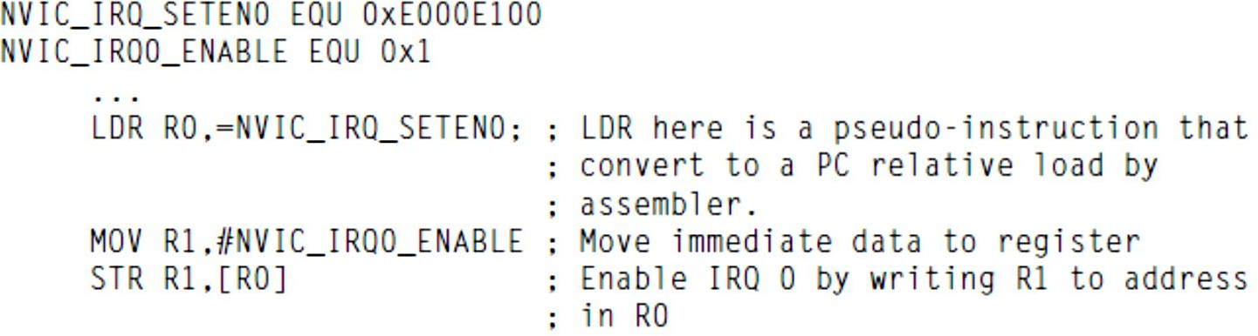
Assembler Language: Basic Syntax (continued)
Constants can be defined using EQU directive, and then they can be used in the program.

Slide 5
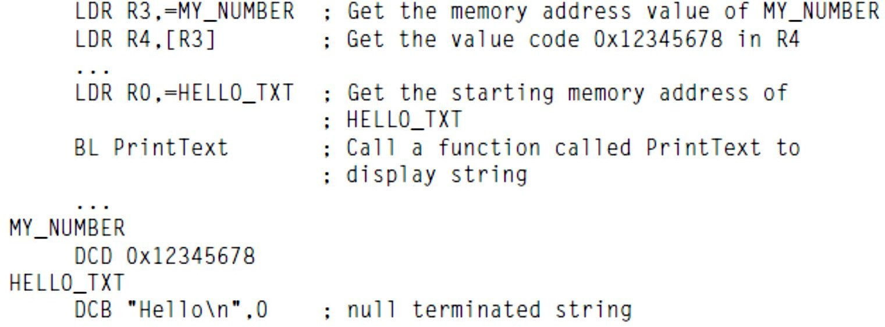
Assembler Language: Basic Syntax (continued)
DCB (Define Constant Byte) can be used for byte size constant values, such as characters, and Define Constant Data (DCD) for word size constant values to define binary data.

Slide 6
Assembler Language: Basic Syntax (continued)
A number of data definition directives are available for insertion of constants inside assembly code.
For example, DCI (Define Constant Instruction) can be used to code an instruction if the assembler cannot generate the exact instruction that you want and if you know the binary code for the instruction.

Slide 7
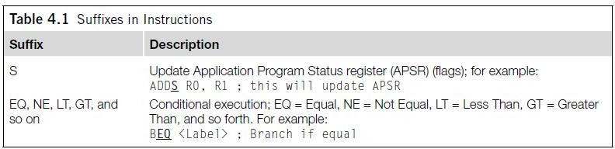
Assembler Language: Use of Suffixes
In assembler for ARM processors, instructions can be followed by suffixes, as shown in Table 4.1.

Slide 8
Assembler Language: Use of Suffixes (continued)
For the Cortex-M3, the conditional execution suffixes are usually used for branch instructions.
However, other instructions can also be used with the conditional execution suffixes if they are inside an IF-THEN instruction block.
In those cases, the S suffix and the conditional execution suffixes can be used at the same time.

Slide 9
Assembler Language: Unified Assembler Language
The Unified Assembler Language (UAL) was developed to allow selection of 16-bit and 32-bit instructions.
Supports and gets the best out of the Thumb-2 instruction set.
With UAL, the syntax of Thumb instructions is now the same as for ARM instructions.
Makes it easier to port applications between ARM code and Thumb code by using the same syntax for both.

Slide 10
Assembler Language: Unified Assembler Language (continued)
The traditional Thumb syntax can still be used.
The choice between whether the instructions are interpreted as traditional Thumb code or the new UAL syntax is normally defined by the directive in the assembly file.
For example, with ARM assembler tool, a program code header with “CODE16” directive implies the code is in the traditional Thumb syntax, and “THUMB” directive implies the code is in the new UAL syntax.

Slide 11
Assembler Language: Unified Assembler Language (continued)
One thing we need to be careful with reusing traditional Thumb is that some instructions change the flags in APSR, even if the S suffix is not used.
However, when the UAL syntax is used, whether the instruction changes the flag depends on the S suffix.
For example,

Slide 12
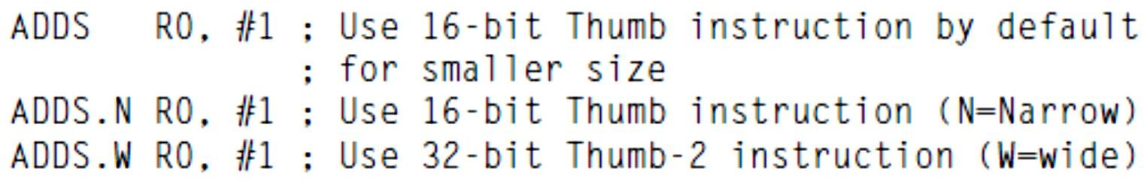
Assembler Language: Unified Assembler Language (continued)
With the new instructions in Thumb-2 technology, some of the operations can
be handled by either a Thumb instruction or a Thumb-2 instruction.
For example, R0 = R0 + 1 can be implemented as a 16-bit Thumb instruction or a 32- bit Thumb-2 instruction.
With UAL, you can specify which instruction you want by adding suffixes:

Slide 13
Assembler Language: Unified Assembler Language (continued)
The .W (wide) suffix specifies a 32-bit instruction.
If no suffix is given, the assembler tool can choose either instruction but
usually defaults to 16-bit Thumb code to get a smaller size.
Depending on tool support, you may also use the .N (narrow) suffix to specify a 16-bit Thumb instruction.
In most cases, applications will be coded in C, and the C compilers will use 16-bit instructions if possible due to smaller code size.
However, when the immediate data exceed a certain range or when the operation can be better handled with a 32-bit Thumb-2 instruction, the 32- bit instruction will be used.

Slide 14
Assembler Language: Unified Assembler Language (continued)
The 32-bit Thumb-2 instructions can be half word aligned.
For example, you can have a 32-bit instruction located in a half word
location.
Most of the 16-bit instructions can only access registers R0–R7.
32-bit Thumb-2 instructions do not have this limitation.
However, use of PC (R15) might not be allowed in some of the instructions.

Slide 15
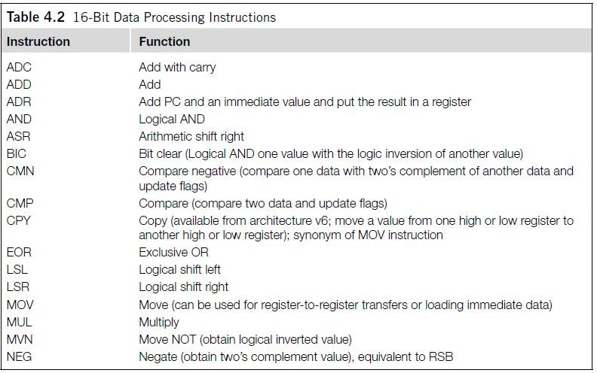
16-Bit Data Processing Instructions

Slide 16
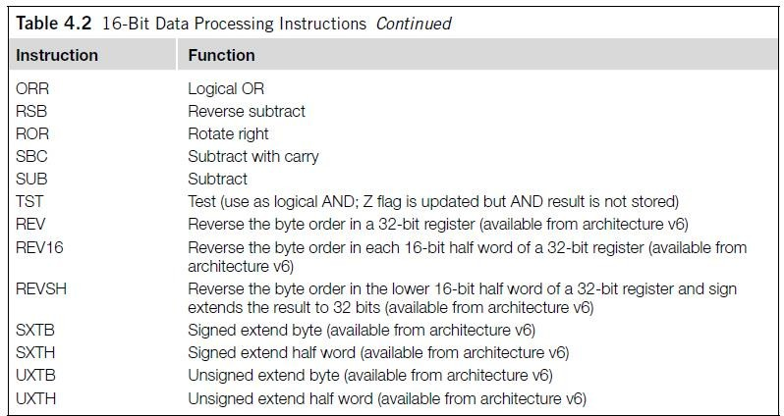
16-Bit Data Processing Instructions (continued)

Slide 17
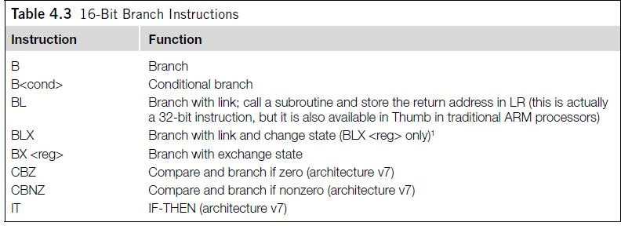
16-Bit Branch Instructions

Slide 18
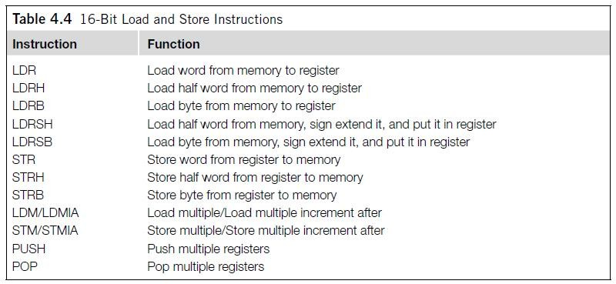
16-Bit Load and Store Instructions

Slide 19
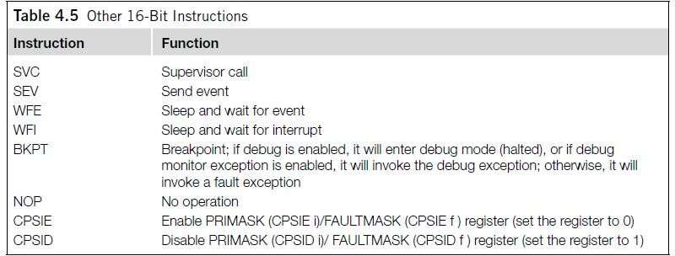
Other 16-Bit Instructions

Slide 20
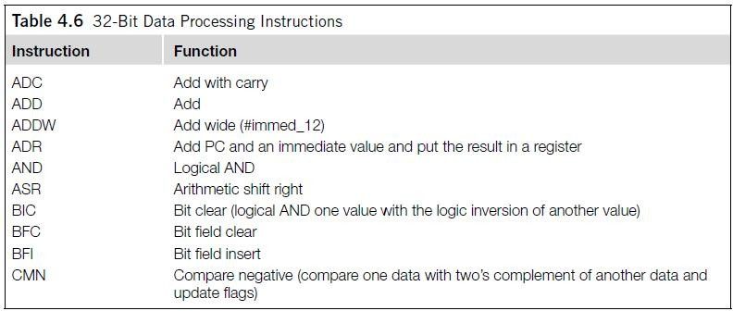
32-Bit Data Processing Instructions

Slide 21
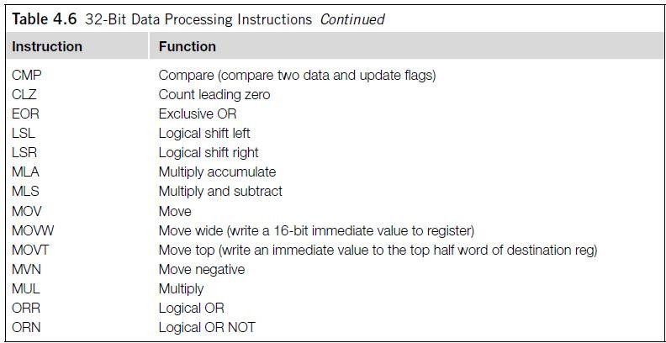
32-Bit Data Processing Instructions (continued)

Slide 22
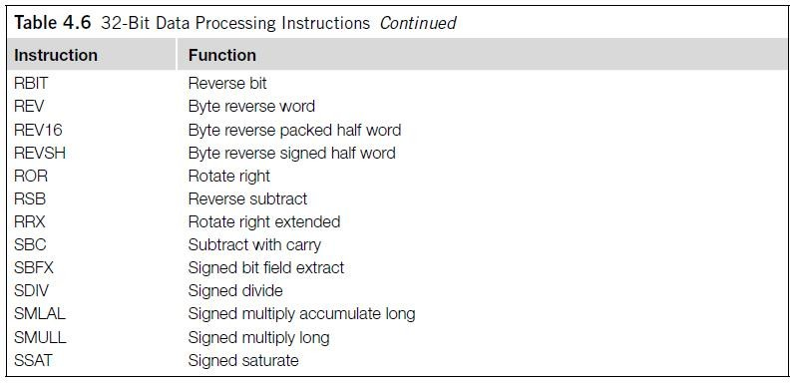
32-Bit Data Processing Instructions (continued)

Slide 23
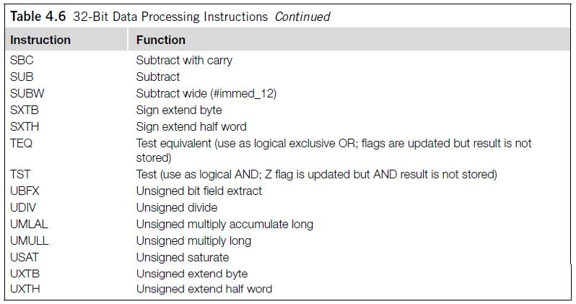
32-Bit Data Processing Instructions (continued)

Slide 24
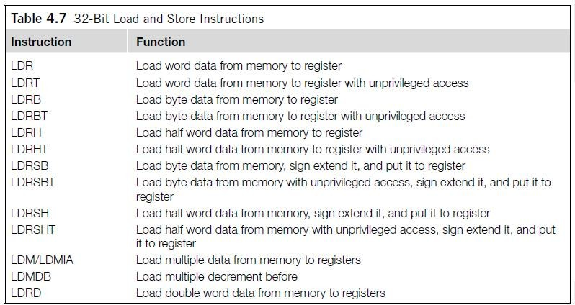
32-Bit Load and Store Instructions

Slide 25
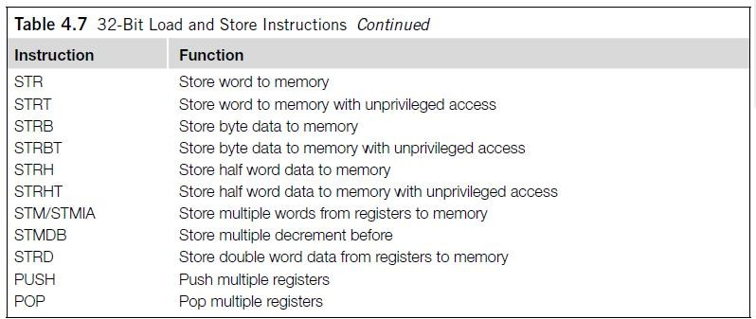
32-Bit Load and Store Instructions (continued)

Slide 26
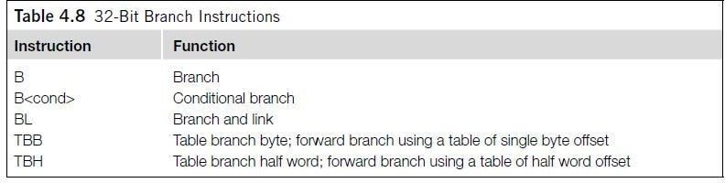
32-Bit Branch Instructions

Slide 27
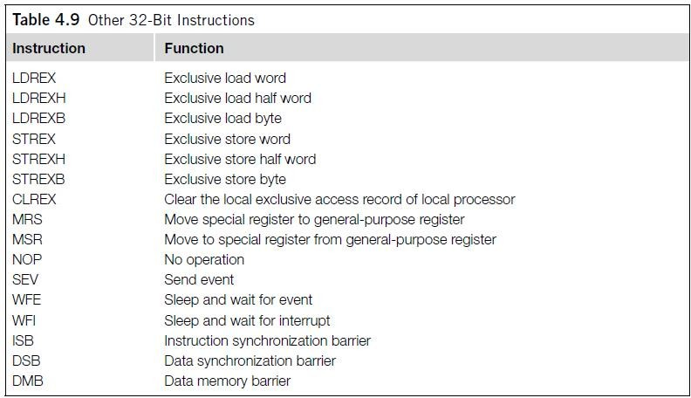
Other 32-Bit Instructions

Slide 28
Assembler Language: Moving Data
One of the most basic functions in a processor is transfer of data.
In the Cortex-M3, data transfers can be of one of the following types:
Moving data between register and register
Moving data between memory and register
Moving data between special register and register
Moving an immediate data value into a register

Slide 29
Assembler Language: Moving Data (continued)
The command to move data between registers is MOV (move).
For example, the instruction
MOV R8, R3
moves data from register R3 to register R8.
Another instruction can generate the negative value of the original data; it is called MVN (move NOT).
MVN R8, R3
performs a bitwise logical NOT operation on data from register R3 and moves it to register R8.

Slide 30
Assembler Language: Moving Data (continued)
The basic instructions for accessing memory are Load and Store.
Load (LDR) transfers data from memory to registers, and Store (STR) transfers data from registers to memory.
The transfers can be in different data sizes (byte, half word, word, and double word), as outlined in Table 4.14.

Slide 31
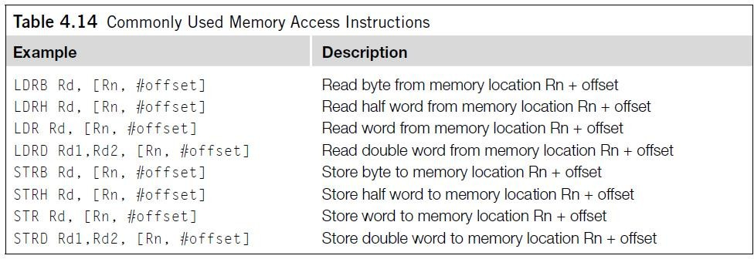
Assembler Language: Moving Data (continued)

Slide 32
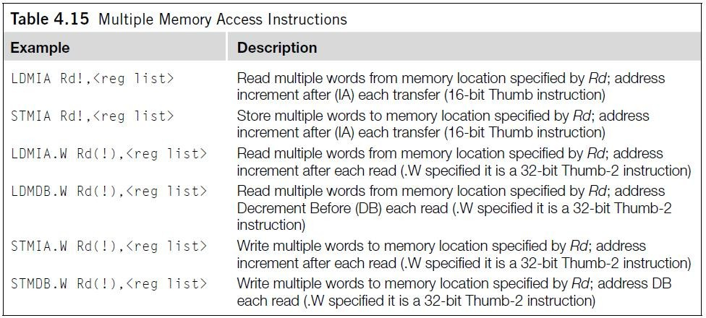
Assembler Language: Moving Data (continued)
Multiple Load and Store operations can be combined into single instructions
called LDM (Load Multiple) and STM (Store Multiple), as outlined in Table 4.15.

Slide 33
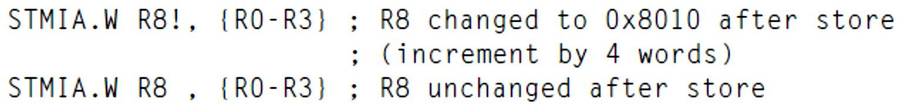
Assembler Language: Moving Data (continued)
The exclamation mark (!) in the instruction specifies whether the register Rd should be updated after the instruction is completed.
For example, if R8 equals 0x8000:

Slide 34
Assembler Language: Moving Data (continued)
ARM processors also support memory accesses with preindexing and postindexing.
For preindexing, the register holding the memory address is adjusted.
The memory transfer then takes place with the updated address.
For example,
The use of the “!” indicates the update of base register R1.
The “!” is optional; without it, the instruction would be just a normal memory transfer with
offset from a base address.
The preindexing memory access instructions include load and store instructions of
various transfer sizes (see Table 4.16).

Slide 35
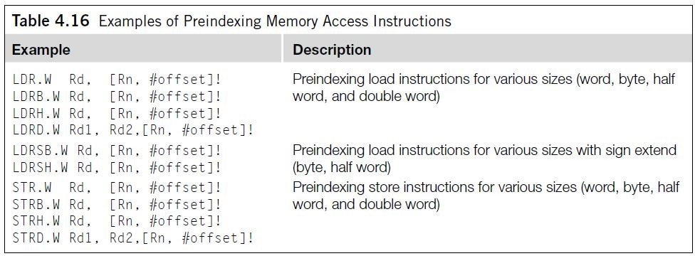
Assembler Language: Moving Data (continued)

Slide 36
Assembler Language: Moving Data (continued)
Postindexing memory access instructions carry out the memory transfer using the base address specified by the register and then update the address register afterward.
For example,
When a postindexing instruction is used, there is no need to use the “!” sign,
because all postindexing instructions update the base address register.
Similarly to preindexing, postindexing memory access instructions are available
for different transfer sizes (see Table 4.17).

Slide 37
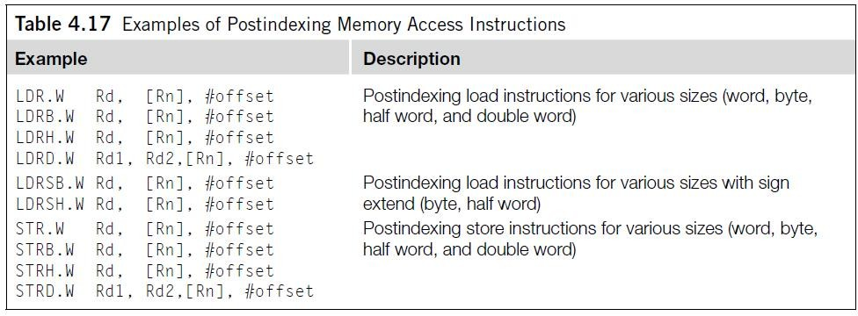
Assembler Language: Moving Data (continued)

Slide 38
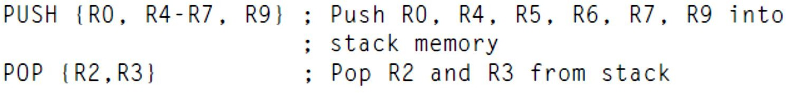
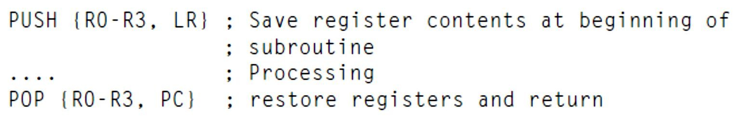
Assembler Language: Moving Data (continued)
Two other types of memory operation are stack PUSH and stack POP.
For example,
Usually a PUSH instruction will have a corresponding POP with the same register list, but this is not always necessary.
For example, a common exception is when POP is used as a function return:
In this case, instead of popping the LR register back and then branching to the
address in LR, we POP the address value directly in the program counter.

Slide 39
Assembler Language: Moving Data (continued)
To access special registers, we use the instructions MRS and MSR.
For example,
Unless you’re accessing the APSR, you can use MSR or MRS to
access other special registers only in privileged mode.

Slide 40
Assembler Language: Moving Data (continued)
Moving immediate data into a register is a common thing to do.
For example, you might want to access a peripheral register, so you need to put the address value into a register beforehand.
For small values (8 bits or less), you can use MOVS (move).
For example,
For a larger value (over 8 bits), you might need to use a Thumb-2 move instruction.
For example,

Slide 41
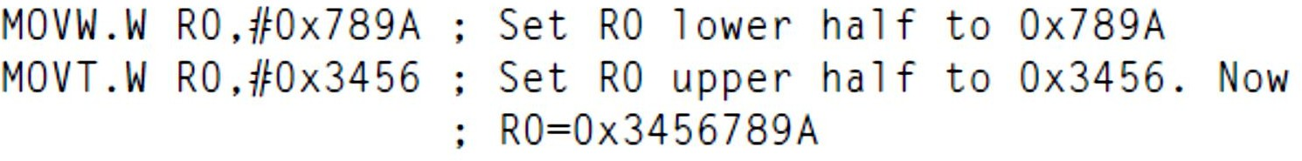
Assembler Language: Moving Data (continued)
Or if the value is 32-bit, you can use two instructions to set the upper and lower halves:

Slide 42
LDR and ADR Pseudo-Instructions
LDR and ADR pseudo-instructions can be used to set registers to a program address value.
This is not a real assembler command, but the ARM assembler will convert it into a PC relative load instruction to produce the required data.
To generate 32-bit immediate data, using LDR is recommended rather than the MOVW.W and MOVT.W combination because it gives better readability and the assembler might be able to reduce the memory being used if the same immediate data are reused in several places of the same program.

Slide 43
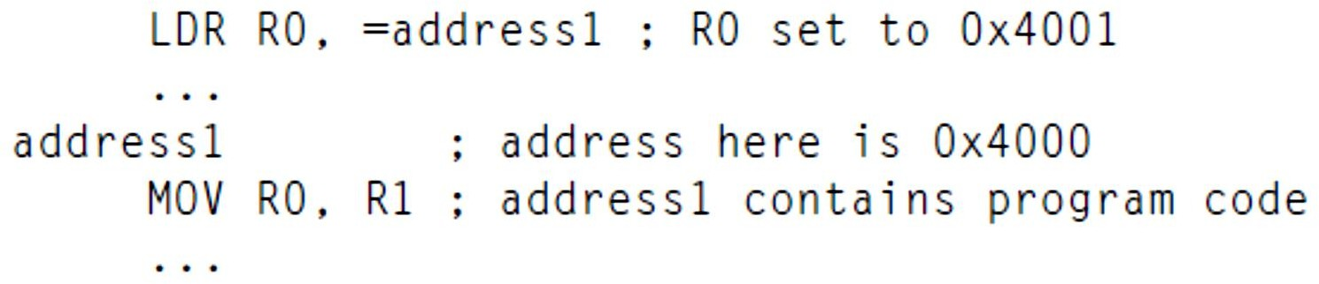
LDR and ADR Pseudo-Instructions (continued)
For LDR, if the address is a program address value, the assembler will automatically set the LSB to 1.
For example,
You will find that the LDR instruction will put 0x4001 into R1; the LSB is set to 1 to indicate that it is Thumb code.

Slide 44
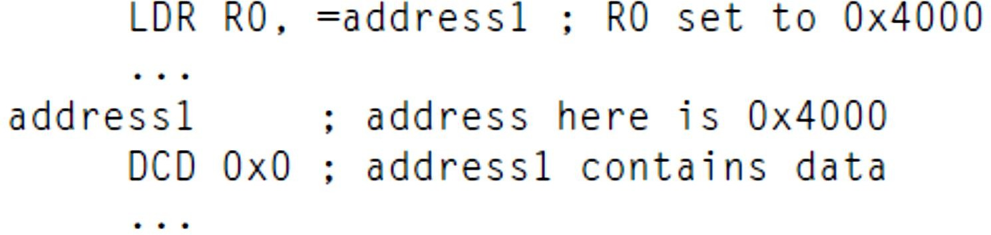
LDR and ADR Pseudo-Instructions (continued)
If address1 is a data address, LSB will not be changed.
For example,

Slide 45
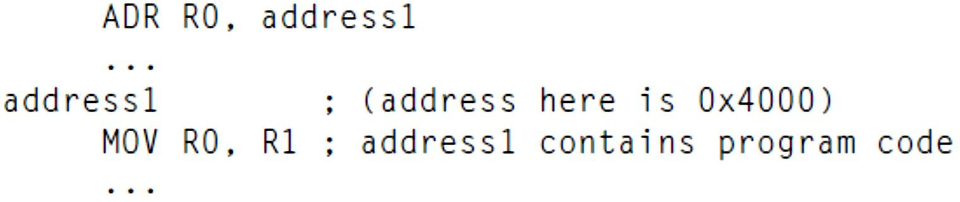
LDR and ADR Pseudo-Instructions (continued)
For ADR, you can load the address value of a program code into a register without setting the LSB automatically.
For example,
You will get 0x4000 in the ADR instruction.
Note that there is no equal sign (=) in the ADR statement.

Slide 46
LDR and ADR Pseudo-Instructions (continued)
LDR obtains the immediate data by putting the data in the program code and uses a PC relative load to get the data into the register.
ADR tries to generate the immediate value by adding or subtracting instructions (for example, based on the current PC value).
As a result, it is not possible to create all immediate values using ADR, and the target address label must be in a close range.
However, using ADR can generate smaller code sizes compared with LDR.

Slide 47
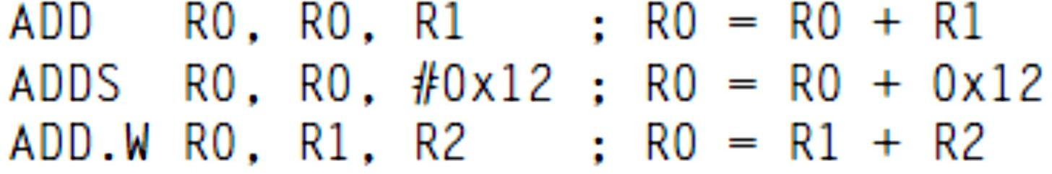
Assembler Language: Processing Data
The Cortex-M3 provides many different instructions for data processing.
Many data operation instructions can have multiple instruction formats.
For example, an ADD instruction can operate between two registers or
between one register and an immediate data value:
These are all ADD instructions, but they have different syntaxes and binary
coding.

Slide 48
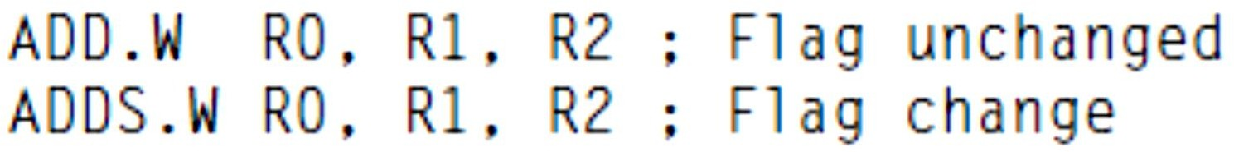
Assembler Language: Processing Data (continued)
With the traditional Thumb instruction syntax, when 16-bit Thumb code is used, an ADD instruction can change the flags in the PSR.
However, 32-bit Thumb-2 code can either change a flag or keep it unchanged.
To separate the two different operations, the S suffix should be used if the following operation depends on the flags:

Slide 49
Assembler Language: Processing Data (continued)
Aside from ADD instructions, the arithmetic functions that the Cortex-M3 supports include subtract (SUB), multiply (MUL), and unsigned and signed divide (UDIV/SDIV).
Table 4.18 shows some of the most commonly used arithmetic instructions.
These instructions can be used with or without the “S” suffix to
determine if the APSR should be updated.
In most cases, if UAL syntax is selected and if “S” suffix is not used, the 32-bit version of the instructions would be selected as most of the 16-bit Thumb instructions update APSR.

Slide 50
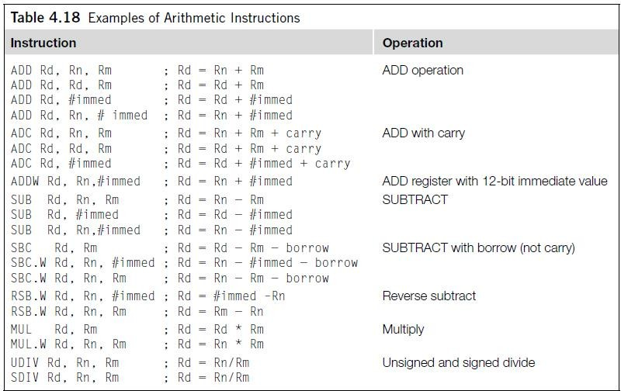
Assembler Language: Processing Data (continued)

Slide 51
Assembler Language: Processing Data (continued)
Another group of data processing instructions are the logical operations instructions and logical operations such as AND, ORR (or), and shift and rotate functions.
Table 4.20 shows some of the most commonly used logical instructions.
These instructions can be used with or without the “S” suffix to
determine if the APSR should be updated.
If UAL syntax is used and if “S” suffix is not used, the 32-bit version of the instructions would be selected as all of the 16-bit logic operation instructions update APSR.

Slide 52
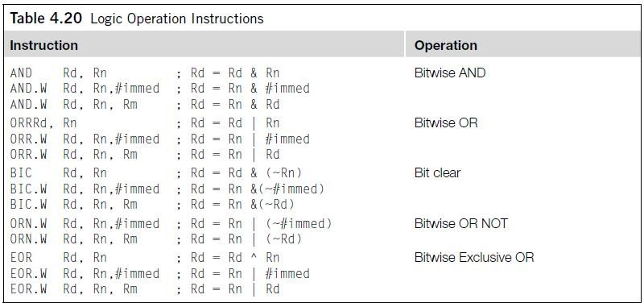
Assembler Language: Processing Data (continued)

Slide 53
Assembler Language: Processing Data (continued)
The Cortex-M3 provides rotate and shift instructions.
In some cases, the rotate operation can be combined with other operations (for example, in memory address offset calculation for load/store instructions).
For standalone rotate/shift operations, the instructions shown in Table 4.21 are provided.
Again, a 32-bit version of the instruction is used if “S” suffix is not
used and if UAL syntax is used.

Slide 54
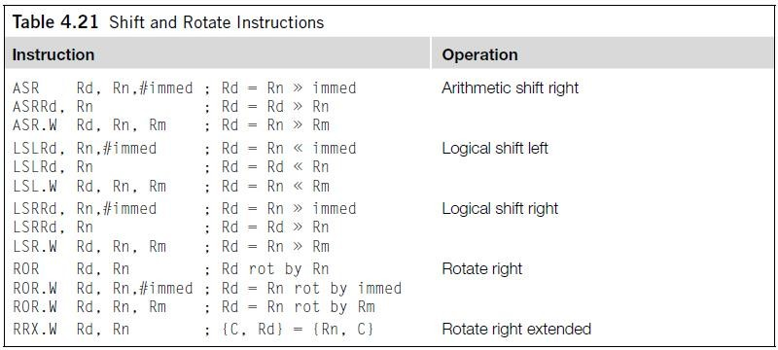
Assembler Language: Processing Data (continued)

Slide 55
Assembler Language: Processing Data (continued)
In UAL syntax, the rotate and shift operations can also update the carry flag if the S suffix is used (and always update the carry flag if the 16-bit Thumb code is used).
See Figure 4.1.
If the shift or rotate operation shifts the register position by multiple bits, the value of the carry flag C will be the last bit that shifts out of the register.

Slide 56
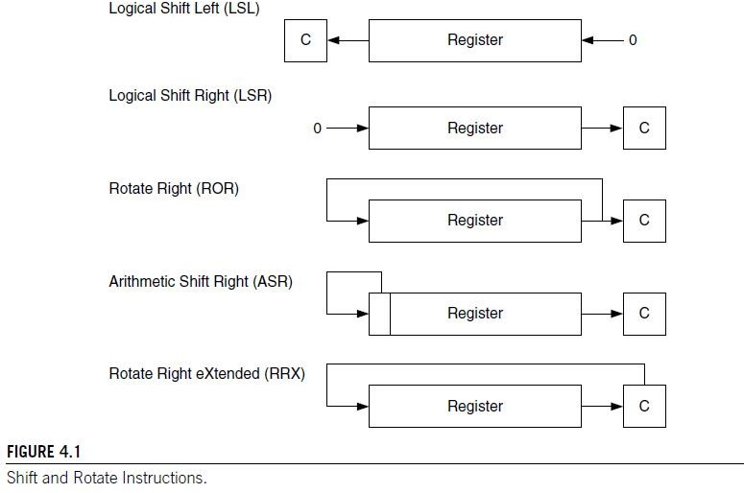
Assembler Language: Processing Data (continued)

Slide 57
Assembler Language: Processing Data (continued)
Why is there rotate right but no rotate left?
The rotate left operation can be replaced by a rotate right operation with a different rotate offset.
For example, a rotate left by 4-bit operation can be written as a rotate right by 28-bit instruction, which gives the same result and takes the same amount of time to execute.

Slide 58
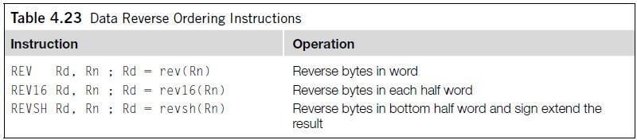
Assembler Language: Processing Data (continued)
Another group of data processing instructions is used for reversing data bytes in a register (see
Table 4.23).
These instructions are usually used for conversion between little endian and big endian data.
See Figure 4.2.
Both 16-bit and 32-bit versions are available.
The 16-bit version can only access low registers.

Slide 59
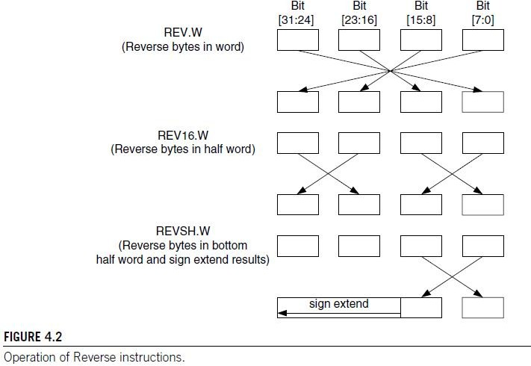
Assembler Language: Processing Data (continued)

Slide 60
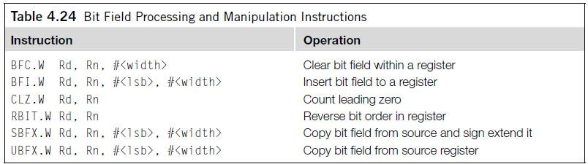
Assembler Language: Processing Data (continued)
The last group of data processing instructions is for bit field processing.
They include the instructions shown in Table 4.24.

Slide 61


SDIV and UDIV
The syntax for signed and unsigned divide instructions is as follows:
The result is Rd = Rn/Rm. For example,
This will give you an R2 result of 60 (0x3C).

Slide 62

REV, REVH, and REVSH
REV reverses the byte order in a data word, and REVH reverses the byte order inside a half word.
For example, if R0 is 0x12345678,
After executing the above instructions, R1 will become 0x78563412, and R2 will be 0x34127856.
REV and REVH are particularly useful for converting data between big endian and little endian.

Slide 63
REV, REVH, and REVSH (continued)
REVSH is similar to REVH except that it only processes the lower half word, and then it sign extends the result.
For example, if R0 is 0x33448899,
After executing the above instruction, R1 will become 0xFFFF9988.

Slide 64
Reverse Bit
The RBIT instruction reverses the bit order in a data word. The syntax is as follows:
This instruction is very useful for processing serial bit streams in data communications. For example, if R0 is 0xB4E10C23 (binary value 1011_0100_1110_0001_0000_1100_0010_0011), then,
After executing above instruction, R0 will become 0xC430872D (binary value 1100_0100_0011_0000_1000_0111_0010_1101).

Slide 65

Bit Field Clear and Bit Field Insert
Bit Field Clear (BFC) clears 1–31 adjacent bits in any position of a register.
The syntax of the instruction is as follows:
For example,
This will give R0 = 0x1234F00F.

Slide 66

Bit Field Clear and Bit Field Insert (continued)
Bit Field Insert (BFI) copies 1–31 bits (#width) from one register to any location (#lsb) in another register.
The syntax is as follows:
For example,
This will give R1 = 0x335678CC.

Slide 67
References
Joseph Yiu, “The Definitive Guide to the ARM Cortex-M3”, 2nd Edition,
Newnes (Elsevier), 2010.
https://www.arm.com

